Slide 1






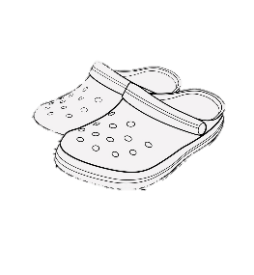




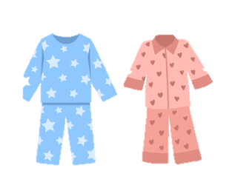








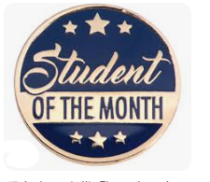

Sunday | Monday | Tuesday | Wednesday | Thursday | Friday | Saturday
 | CROC-TOBER PURCHASE YOUR TICKETS ON THE SCHOOL STORE! October 1st – 31st |  | 1 Wear Pink for $2.00 Breast Cancer Awareness! PIZZA & JUICE $3 | 2 | 3 | 4
5 FREE | 6 | 7 | 8 | 9 | 10 | 11
12 | 13 | 14 | 15 Wear Pink for $2.00 Breast Cancer Awareness! PIZZA & JUICE $3 | 16 | 17 | 18
19 | 20 | 21 | 22 ICECREAM DAY $2 | 23 WEAR RED FOR RED RIBBON WEEK! | 24 | 25
26 | 27 Say “BOO” to Drugs, wear an Orange Shirt | 28 | 29 | 30 October Dance K-5 – In School 6-8 – 4:00-5:30PM TICKETS REQUIRED | 31 Wear your Book Character Costumes
BridgePrep Academy of Hollywood Hills
No School
School Picture Day. You must come in FULL Uniform.
Twin for the win Dress up like a pal for
twin day
Sports Day
Wear your favorite sports Jersey/Shirt
COLOR WARS
Wear Your Class Color from Head to Toe!
Pajama Day
EARLY RELEASE
Crazy Hair & Crazy Sock Day!
Teacher Planning Day
School T-shirt Day
with uniform bottom
No School
School T-shirt Day
with uniform bottom
Health Screening Day
Health Screening Day

